Slide 1
Math 32
Lecture 1: Introduction
Derek Sollberger (dsollberger@ucmerced.edu)

Slide 2
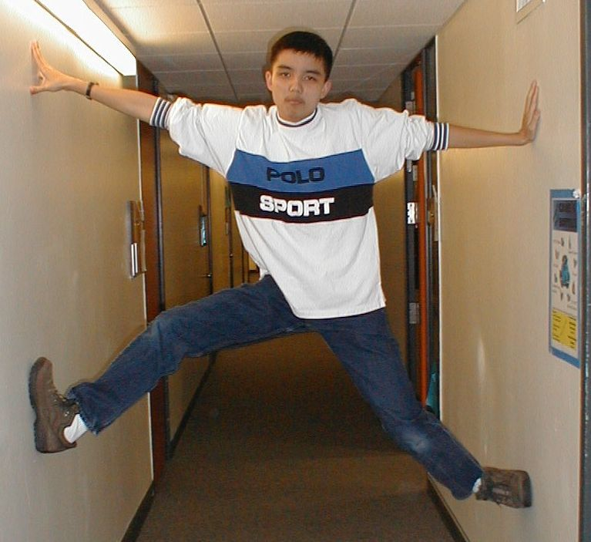
Introducing the Presenter
Lecturer: Derek Sollberger
Originally from Los Angeles
BA in Applied Mathematics, UC Berkeley
MS in Applied Mathematics, CSULB
MS in Applied Mathematics, UC Merced

Slide 3

Introducing the Presenter
Continuing Lecturer in Applied Mathematics
8+ years of teaching at UC Merced
Courses:
Bio 18: Data Science
Bio 175: BioStatistics
Bio 184: Python for Bioinformatics
Math 32: Probability and Statistics
Current research:
Pedagogy, sports analytics

Slide 4
Why Probability?
The “classic” birthday problem:
How many students have to enter the Twitch stream until there are two students that share a birthday?

Slide 5
Deterministic vs Probabilistic
Deterministic: a situation that can be solved with equation solving and/or an algorithm
Example: If water boils at 100 degrees Celsius, what is that threshold in Fahrenheit?
Probabilistic: a situation that cannot be completely solved due to an element of chance
Example: What is the chance that it will rain tomorrow?

Slide 6
Probability and You
Applied Mathematics
Does a probabilistic sequence converge or diverge?
Bioengineering
What percentage of lyme disease patients would be cured with the current but experimental treatments?
Chemical Sciences
What proportion of reactants undergo a reaction early in the reaction?
Computer Science and Engineering
How many computers in a network would be affected after a virus infection?

Slide 7
Probability and You
Environmental Engineering
How many of a certain species of plants are in the Vernal Pools Reserve?
Materials Science and Engineering
What percentage of a semiconductor is made of impurities?
Mechanical Engineering
For a commercial passenger airplane, what is the probability that at least two engines fail during a flight?
Physics
How many stars are in the Milky Way?

Slide 8
Ugh, the syllabus
Course Description:
Concepts of probability and statistics. Conditional probability, independence, random variables, distribution functions, descriptive statistics, transformations, sampling errors, confidence intervals, least squares and maximum likelihood. Exploratory data analysis and interactive computing.

Slide 9
For the School of Natural Sciences
Course Learning Outcomes:
Develop probabilistic models of random phenomena.
Infer statistical models from real data.
Apply mathematical methods to probabilistic/statistical models to
Make predictions and
Quantify the uncertainty in these predictions.
Write and run “simple” R programs for the purposes of data analysis, modeling, and visualization.
Program Learning Outcomes
Solve mathematical problems using analytical methods
Solve mathematical problems using computational methods
Recognize the relationships between different areas of mathematics and the connections between mathematics and other disciplines
.
.

Slide 10
Assessment
Category | Percentage
Discussion section participation | 10
Surveys | 5
Written homework | 25
Programming homework | 25
Exam 1 (Friday, February 26) | 10
Exam 2 (Friday, April 16) | 10
Final Exam (Thursday, May 13) | 15

Slide 11
Of note
Special Accommodations: University of California, Merced is committed to creating learning environments that are accessible to all. If you anticipate or experience physical or academic barriers based on a disability, please feel welcome to contact me privately so we can discuss options. In addition, please contact Student Accessibility Services (SAS) at (209) 228-6996 or disabilityservices@ucmerced.edu as soon as possible to explore reasonable accommodations. All accommodations must have prior approval from Student Accessibility Services on the basis of appropriate documentation. If you anticipate or experience barriers due to pregnancy, temporary medical condition, or injury,please feel welcome to contact me so we can discuss options. You are encouraged to contact the Dean of Students for support and resources at (209) 228-3633 or https://studentaffairs.ucmerced.edu/dean-students.
Academic Integrity: Academic integrity is the foundation of an academic community and without it none of the educational or research goals of the university can be achieved. All members of the community are responsible for its academic integrity. Existing policies forbid cheating on examinations, plagiarism and other forms of academic dishonesty. The UC Merced Academic Honesty Policy The UC
Merced Academic Honesty Policy can be found on the Student Conduct website. Infractions against academic integrity will incur consequences such as an “F” on the assignment/exam and/or a report to the Academic Senate.

Slide 12
Nerdy Example
How many numbers between zero and one do we have to add up to have a sum that is greater than one?
Assume selection from a uniform distribution

Slide 13
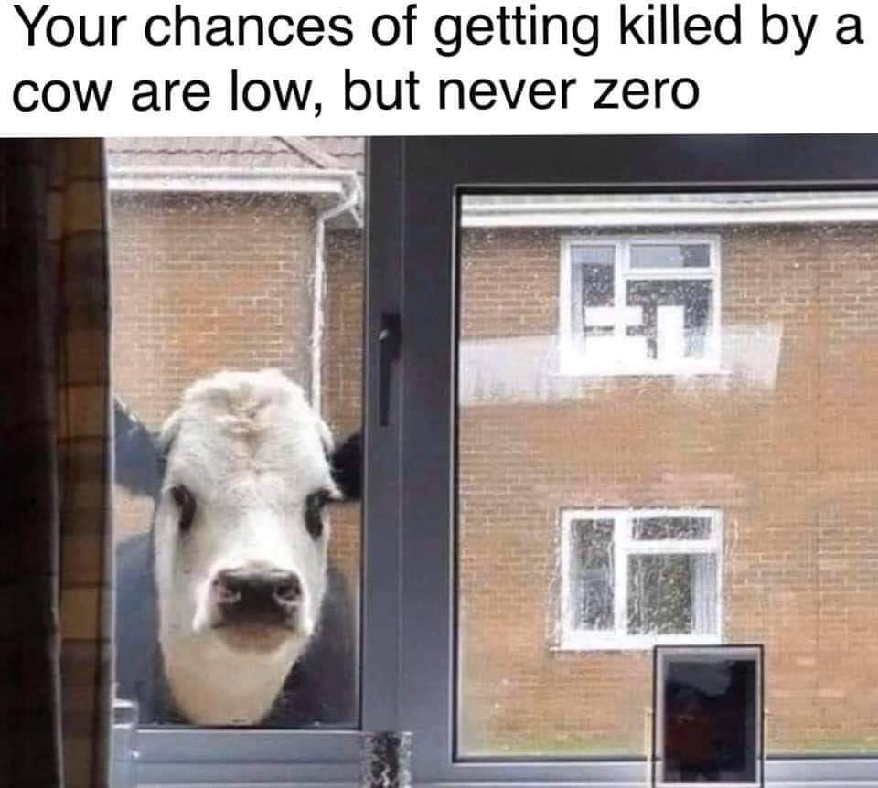
Upcoming

